Slide 1
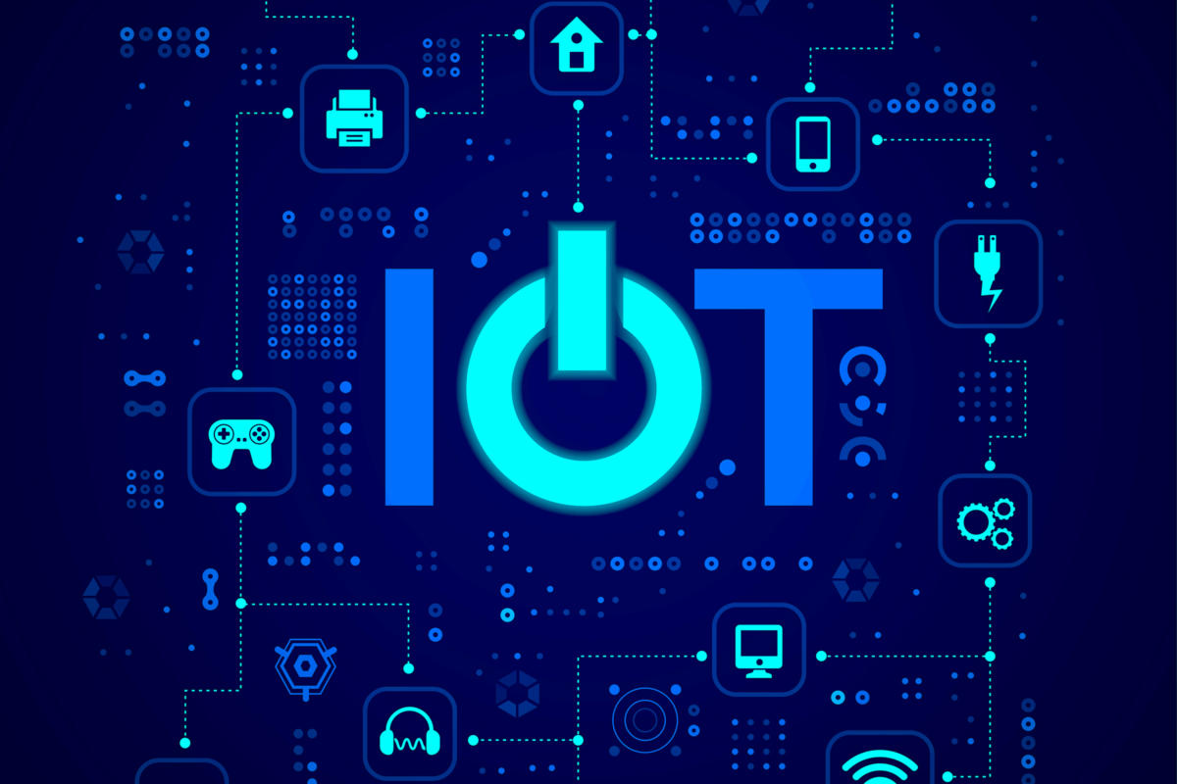
Chapter 2: Internet of Things (IoT)

Slide 2
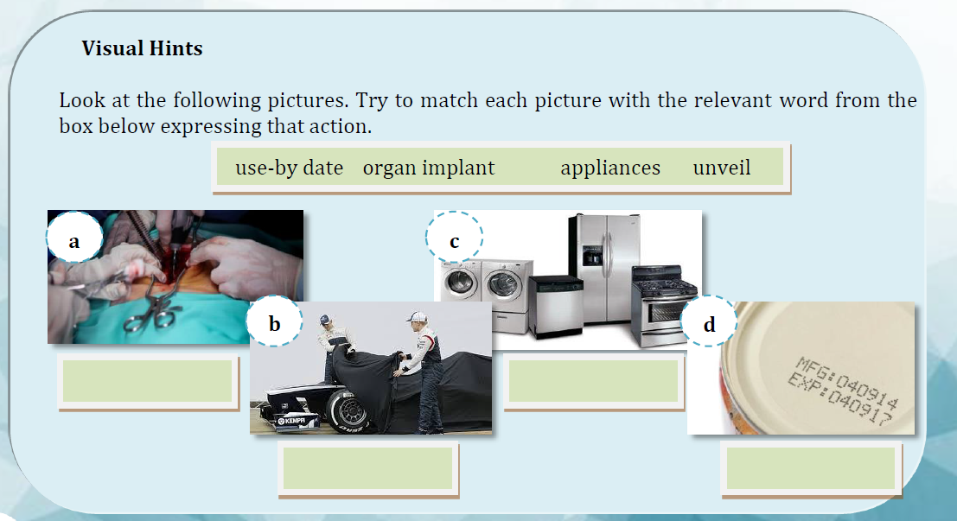

Slide 3


Slide 4
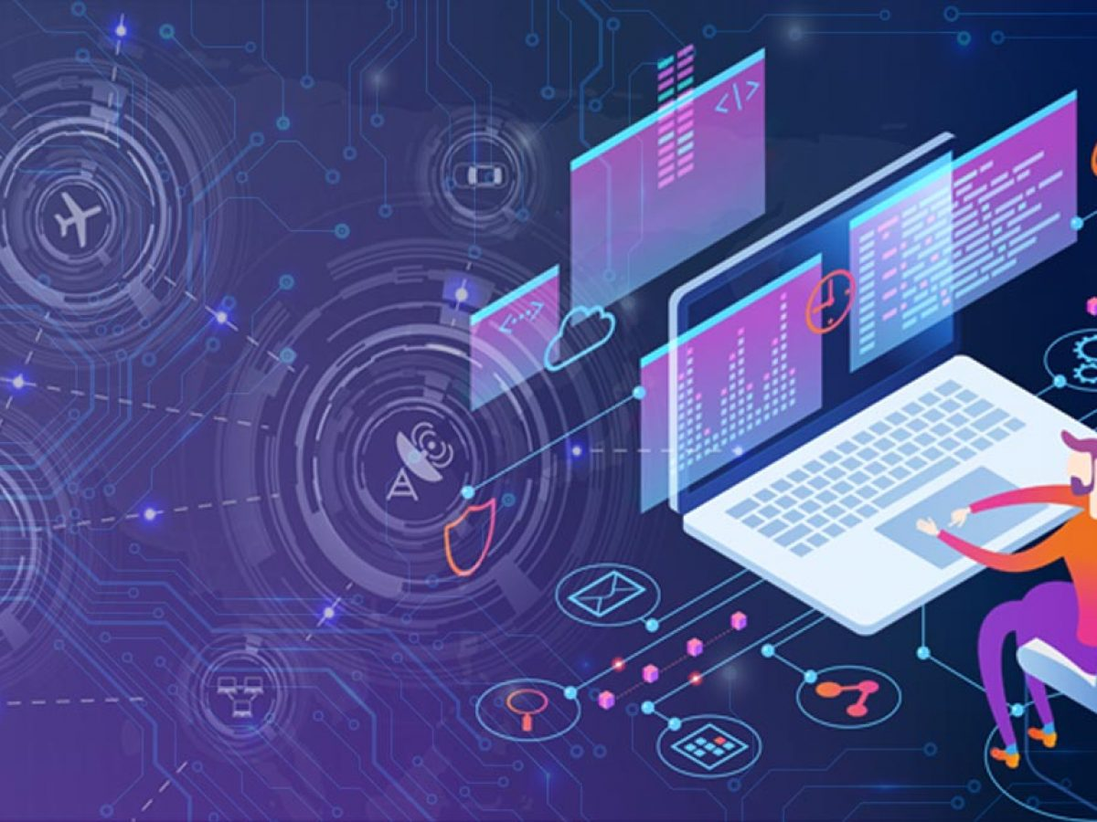
The internet of things (or as it is also known, IoT) is not new: tech companies have been discussing the idea for decades, and the first internet-connected toaster was unveiled at a conference in 1989. IoT is about connecting devices over the internet, letting them talk to us and each other. Cars, kitchen appliances, and even heart monitors can all be connected through the IoT. A thing, in the internet of things, can be a person with a heart monitor implant, an automobile that has sensors to alert the driver when tire pressure is low, or any other natural or man-made object that can be assigned an IP address and provided with the ability to transfer data over a network.

Slide 5
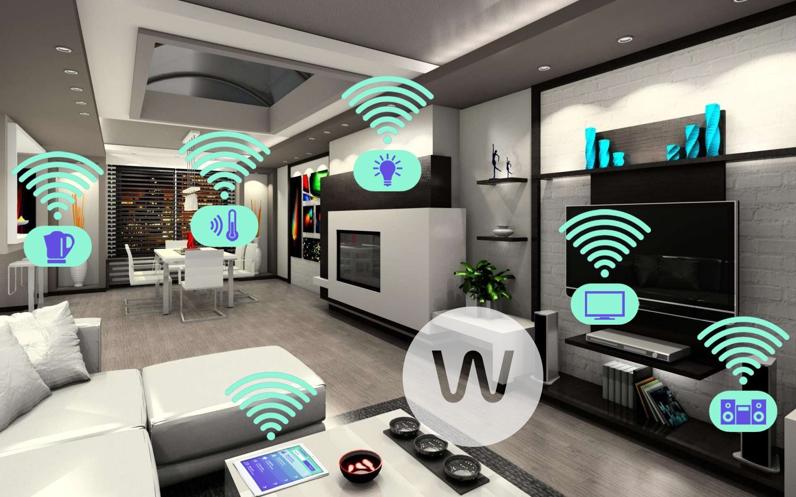

Slide 6
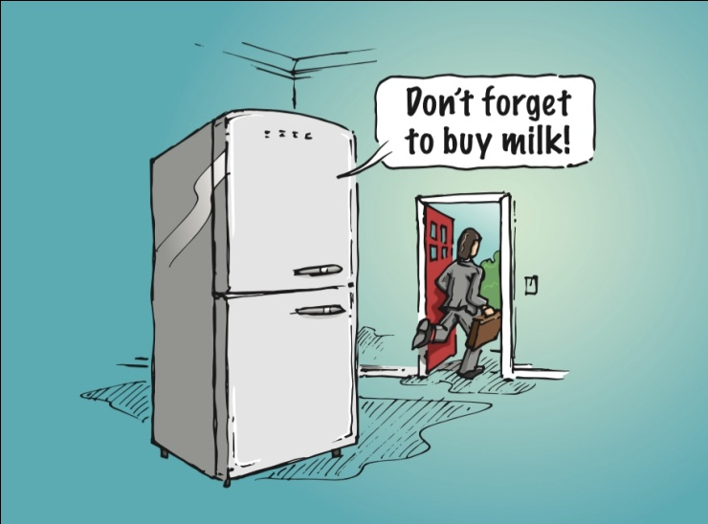
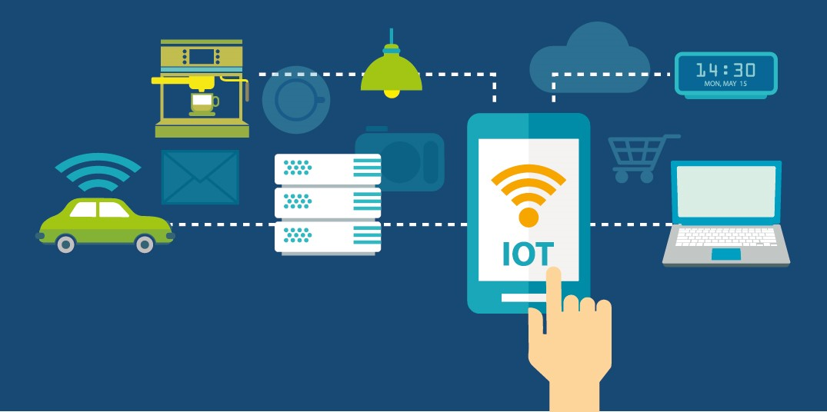
As the Internet of Things continues to grow, more devices will join that list. The popular example is the smart fridge: what if your fridge could tell you it was out of milk, texting you if its internal cameras saw there was none left, or that the carton was past its use-by date?
IoT is more than smart homes and connected devices, however. It also include smart cities – think of connected traffic lights that monitor traffic and tell us to slow down or how many spaces are left in a car park, or smart bins that signal when they need to be emptied – and industry, with connected sensors for monitoring crops.

Slide 7


Is it Safe?
Everything new has downsides, and security and privacy are the biggest challenges for IoT. All these devices and systems collect a lot of personal data about people – when you are home and what electronics you use when you are there – and it is shared with other devices and held in databases by companies. Despite these, hackers have not put much attention to IoT because there is likely not many people using connected devices for an attack against them to be worth, but as soon as there is a financial benefit to hacking smart homes, the cyber crimes related to it will also increase.

Slide 8

So the short answer is yes, IoT is relatively safe: you are not likely to face serious loss or damage because of your smart meter. However, there is no guarantee, and so far not enough is being done to ensure IoT is not the next big hacking target. As a result, several tech companies are focusing on cyber security in order to secure the privacy and safety of all this data.

Slide 9
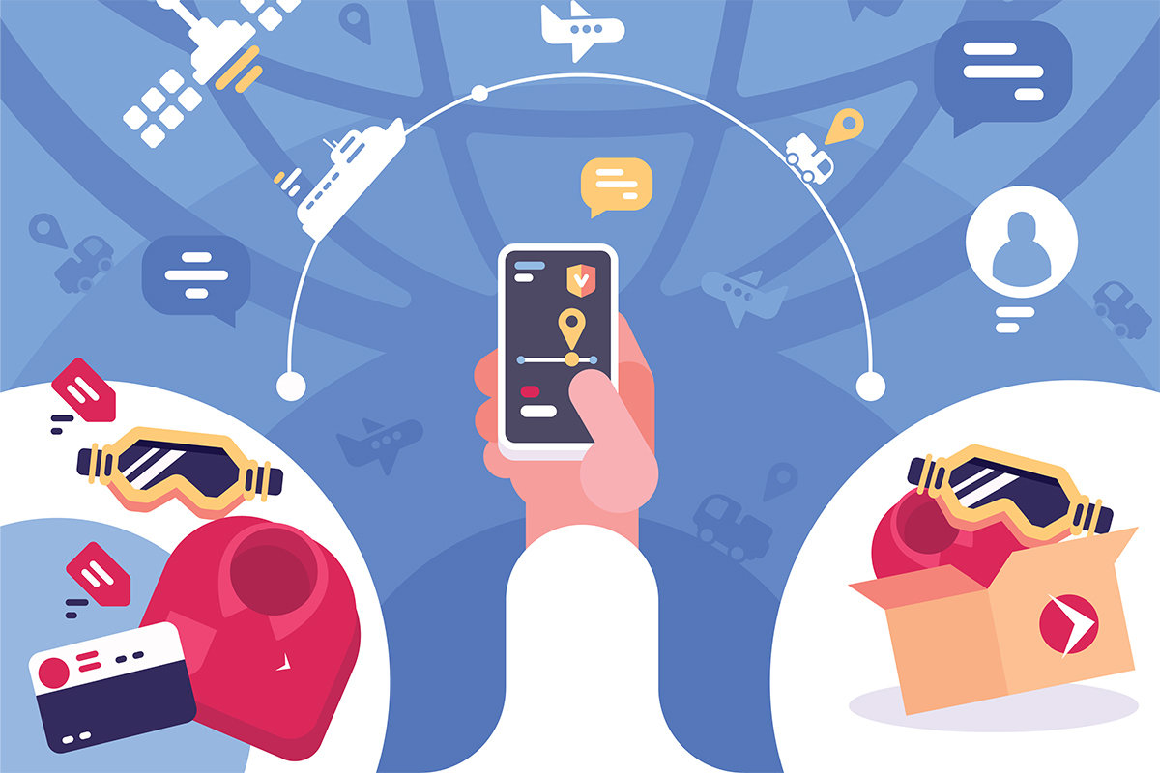
How will the Internet of Things Affect Business and Work?
This all depends on the type of industry: manufacturing is perhaps one of the targets as IoT can help manufacturers to organize tools, machines, and people, and track where they are. There are literally hundreds of companies like Amazon linked to the Internet of Things, and the list should only expand in the coming years. Businesses are also top adopters of IoT solutions because they use IoT to: lower operating costs, increase productivity, and expand to new markets or develop new product offerings.

Slide 10
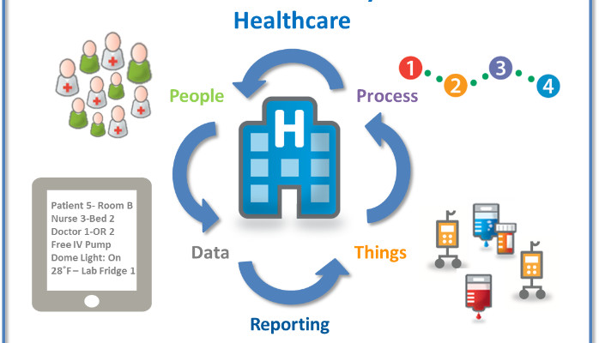
Farmers have also been turning to connected sensors to monitor both crops and cattle, in the hopes of improving production and efficiency and tracking the health of their herds. The examples are endless, and all we can predict is that connected devices will likely make their ways into most businesses, just the way computers and the Internet have. Imagine your security access card being used to track where you are in the building, so your boss can calculate how much time you are spending in the kitchen making tea.
Another interesting example is a printer capable of telling the print service company when it is running out of toner. Detailed information such as the exact nature of the problem and parts required to fix it can be transmitted to the service provider and their engineers, largely improving the possibility of a first-time fix.

Slide 11
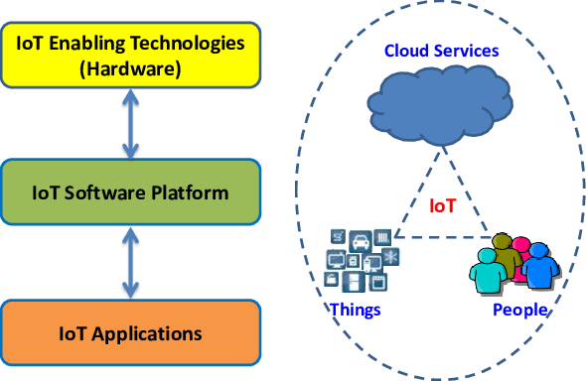
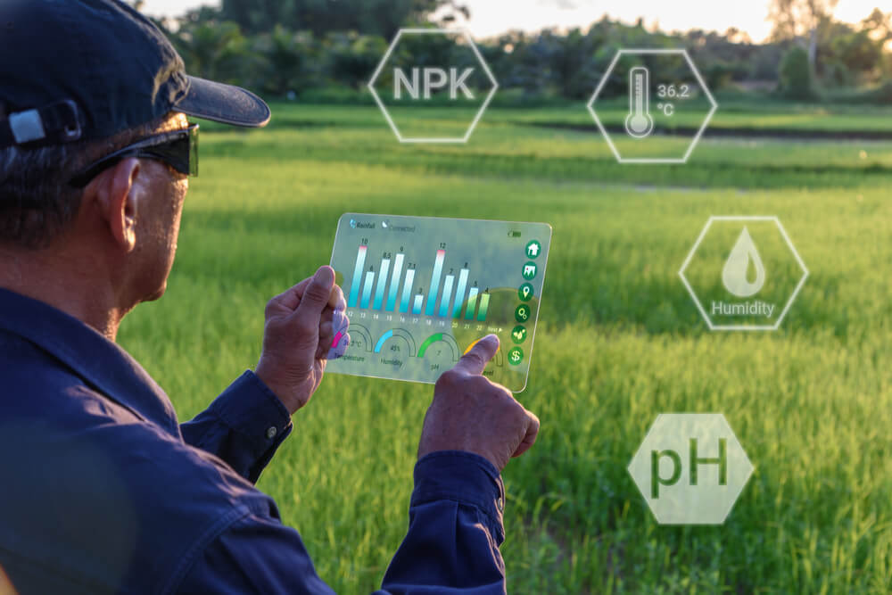
What will internet of things look like in the future?
Technology is full of ups and downs – it is often difficult to decide on whether an innovation is truly ground-breaking or not. But the internet of things is one of those wider ideas that is not dependent on a single project or product. Smart fridges may well be the appliance of the future, or pushed away by newer technologies, but the idea of smart devices making decisions without our input will continue. IoT is still in its infancy, but with thousands of new devices going online every day, all service organizations will soon be using it. A decade from now, everything could be connected. No matter where it is or what we call it, IoT is real – but what it will look like in the future is something even Google cannot answer.

Slide 12


